Slide 1
AdaBoost: A Decision-Theoretic Generalization of On-Line Learning
Freund, Y. & Schapire, R. E. (1997)

Slide 2
Introduction
Boosting improves the accuracy of weak learning algorithms.
This paper introduces AdaBoost with a decision-theoretic foundation.

Slide 3
Learning Framework
Considers Both On-Line and Batch Learning Settings.
Weak learners perform slightly better than random guessing.

Slide 4
Objective
Combine Weak Hypotheses into a Strong Classifier.
Provide Guarantees on Error Reduction.
Example: Suppose there are 25 base classifiers.
Each classifier has error rate, ε = 0.35. Assume classifiers are independent.
  Probability that the ensemble classifier makes a wrong prediction:

Slide 5
Core Idea
Maintain a distribution over training examples.
Focus learning on hard-to-classify examples.

Slide 6
AdaBoost Algorithm
Initialize Weights Uniformly.
Iteratively Train Weak Learners.
Weight Each Learner based on its Error.
Combine Learners by Weighted Voting.

Slide 7
Weight Update Mechanism
Misclassified examples receive higher weights.
Correctly classified examples receive lower weights.
Example 4 is hard to classify
Its weight is increased, therefore it is more likely to be chosen again in subsequent rounds

Slide 8
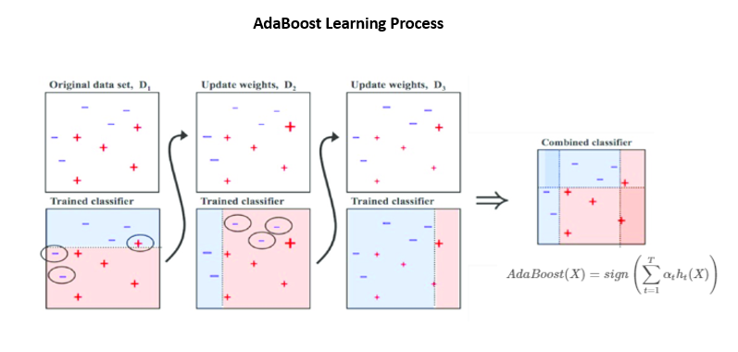

Slide 9
Error Bounds
Training error decreases exponentially.
Bounds derived using decision-theoretic analysis.

Slide 10
Loss Perspective
Minimizes an Exponential Loss Function.
Explains Consistent Performance Improvements.

Slide 11
Advantages
Simple and Efficient.
Strong Theoretical Guarantees.
Works Well with Weak Learners.

Slide 12
Conclusion
AdaBoost shows that weak learners can be boosted into a strong learner.
Forms the basis for many ensemble methods.

